Slide 1
WaveNet
A generative model for raw audio

Slide 2
What we will talk about?
WaveNet in a few words;
Before WaveNet;
Architecture (Based on PixelCNN);
Dilated causal convolutions;
More about architecture: softmax, GAU, residual&skip connections;
Conditional WaveNets;
Experiments: TTS, music&speech generation;
Cons => development of WaveNet.

Slide 3
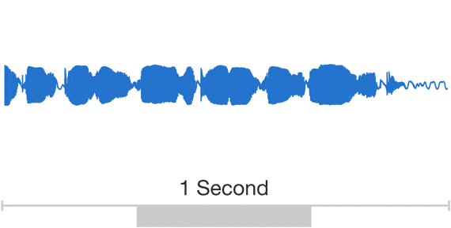
WaveNet in a few words
What is it?
Fully probabilistic & autoregressive model
based on the PixelCNN architecture.
What it does?
Directly modelling the raw waveform of
the audio signal, one sample at a time.
Why?
A second of generated speech
Naturalness of produced speech.

Slide 4

Before WaveNet
Concatenative TTS
Parametric TTS
Very large database of short speech fragments are recorded from a single speaker and then recombined to form complete utterances.
All the information required to generate the data is stored in the parameters of the model, and the contents and characteristics of the speech can be controlled via the inputs to the model.
Let’s compare:

Slide 5
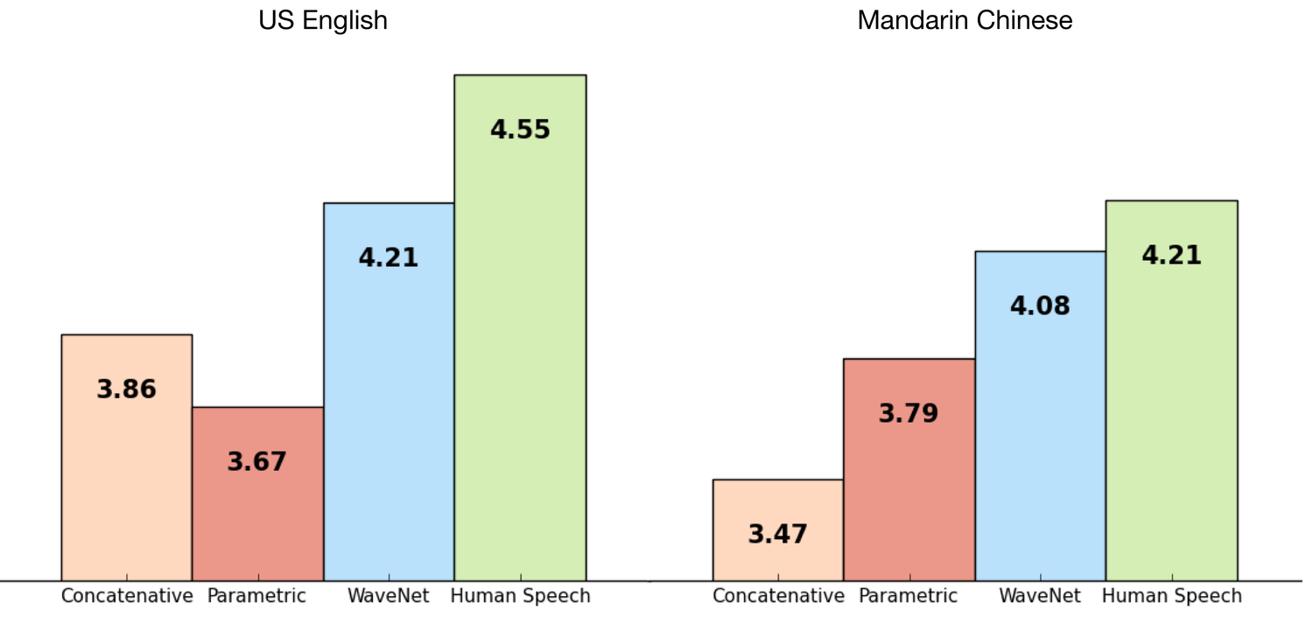
WaveNet cooler? Let’s observe MOS

Slide 6
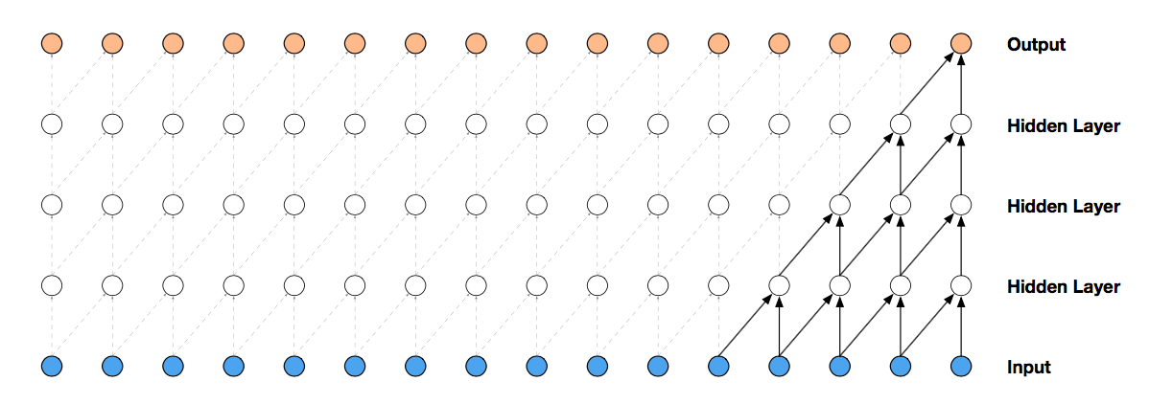
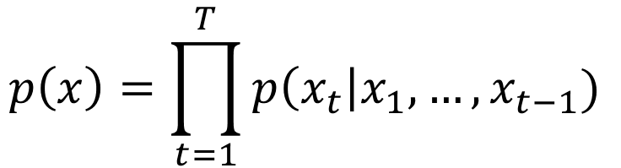
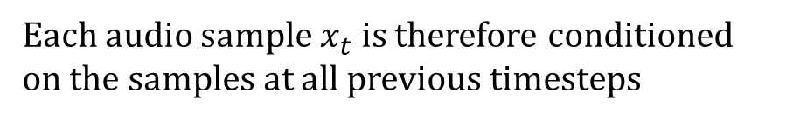
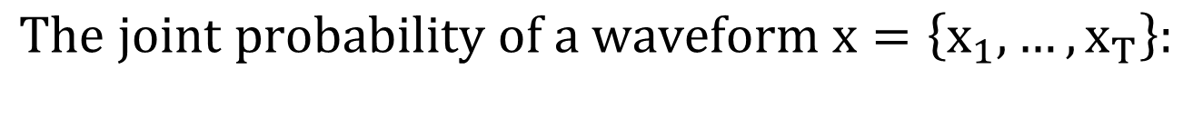
Architecture (Based on PixelCNN)
$$The joint probability of a waveform x=\left\{x_{1},…, x_{T}\right\}:$$
$$p\left(x\right)=\prod_{t=1}^{T}{p\left(x_{t}\right|x_{1},…, x_{t−1}) }$$
Each audio sample $x_{t}$ is therefore conditioned on the samples at all previous timesteps

Slide 7

Dilated causal convolutions: what?
Output
Dilation = 8
Hidden layer
Dilation = 4
Hidden layer
Dilation = 2
Hidden layer
Dilation = 1
Input

Slide 8
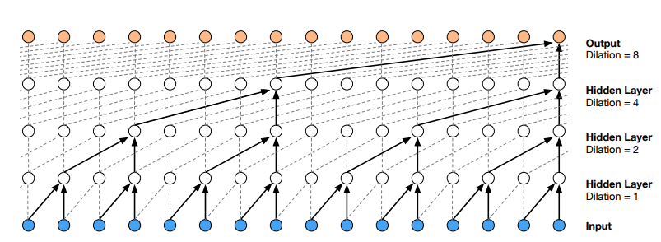
Dilated causal convolutions: why?
The reason we need such convolutions is receptive field size increase without greatly increasing computational cost:
A dilated convolution effectively allows the network to operate on a coarser scale than with a normal convolution.
Stack of dilated causal convolutional layers
This paper:
1, 2, 4, . . . , 512, 1, 2, 4, . . . , 512, 1, 2, 4, . . . , 512.

Slide 9
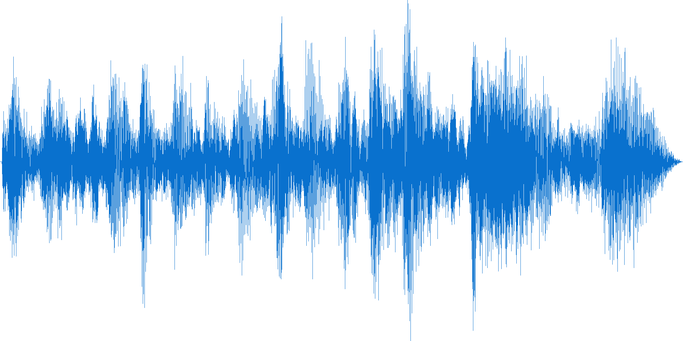
Softmax distribution
$$p\left(x_{t}\right|x_{1},…, x_{t−1})= … MDN?MCGSM?Softmax distribution!$$
Sequence of 16-bit integer values
(one per timestep)
65,536 probabilities per timestep
$$f\left(x_{t}\right)=sign\left(x_{t}\right)\frac{\ln\left(1+μ \left|x_{t}\right|\right)}{ln⁡(1+μ)}, where −1<x<1 and μ=255$$

Slide 10
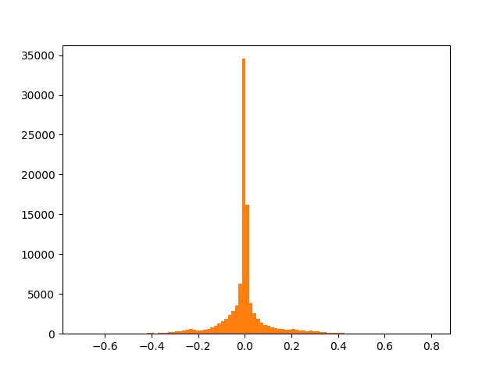
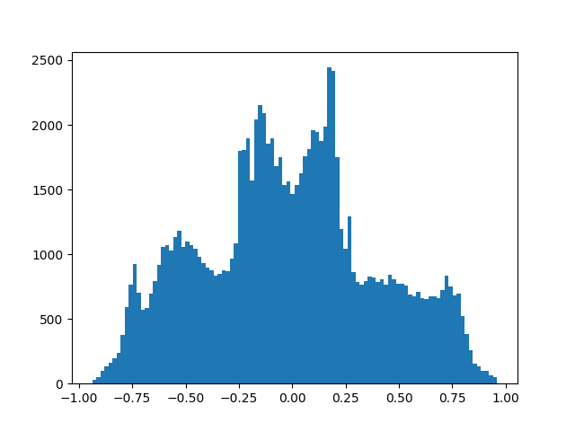

$μ−law$ visulization

Slide 11
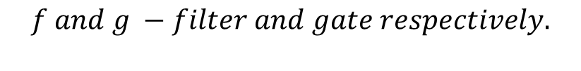
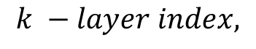
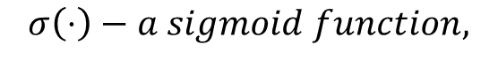
Gated Activation Units
Same as used in gated PixelCNN:
Interesting detail: this non-linearity worked significantly better than the rectified linear activation function for modeling audio signals.
$$z=\tanh\left(W_{f,k}∗x\right)⊙σ\left(W_{f,k}∗x\right), where$$
$$∗− convolution operator,$$
$$⊙− element−wise multiplication operator,$$
$$σ\left(⋅\right)−a sigmoid function,$$
$$k −layer index,$$
$$f and g −filter and gate respectively.$$

Slide 12
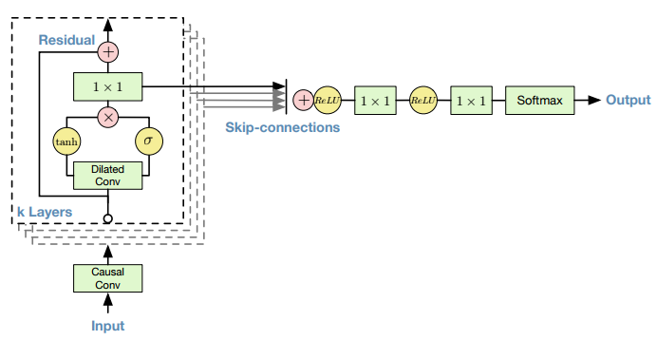
Architecture in one picture
Both residual and parameterised skip connections are used throughout the network, to speed up convergence and enable training of much deeper models

Slide 13
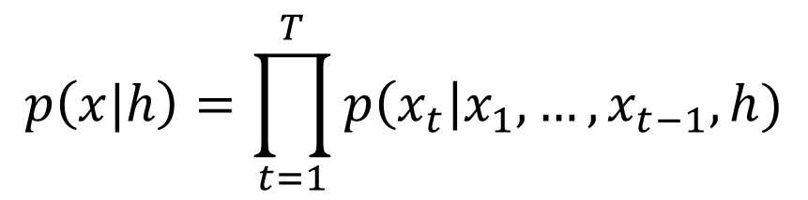
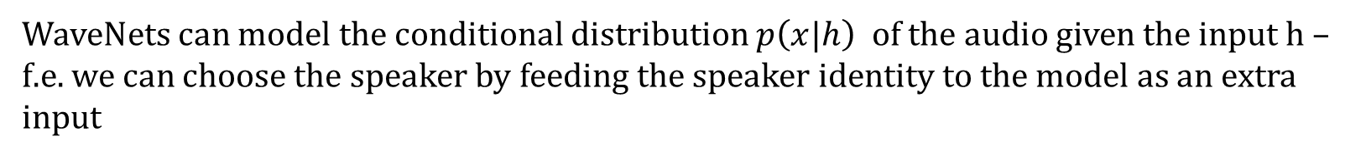
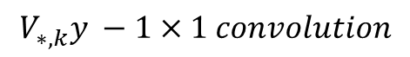
Conditional WaveNets
WaveNets can model the conditional distribution $p\left(x|h\right)$ of the audio given the input h – f.e. we can choose the speaker by feeding the speaker identity to the model as an extra input
$$p\left(x|h\right)=\prod_{t=1}^{T}{p\left(x_{t}\right|x_{1},…, x_{t−1}, h)}$$
$$z=\tanh\left(W_{f,k}∗x+V_{f,k}^{ }y\right)⊙σ\left(W_{f,k}∗x+V_{g,k}^{ }y\right),$$
$$z=\tanh\left(W_{f,k}∗x+V_{f,k}^{T}h\right)⊙σ\left(W_{f,k}∗x+V_{g,k}^{T}h\right),$$
$$V_{∗,k}^{ } −a learnable linear projection$$
$$V_{∗,k}^{ }y −1×1 convolution$$
$$V_{∗,k}^{ T}h − broadcast over the time dimension$$
Global conditioning: single latent representation h
Local conditioning: second timeseries $h_{t}⇒y=f(h)$

Slide 14

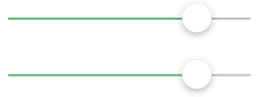



Multispeaker speech generator results
Predictions conditioned only on the previous audio samples (not on a text) = bla-bla
Changing identity of a speaker:
or
or
or
+ emotions
+ accents
Interesting detail: adding speakers resulted in better validation set performance compared to training solely on a single speaker

Slide 15
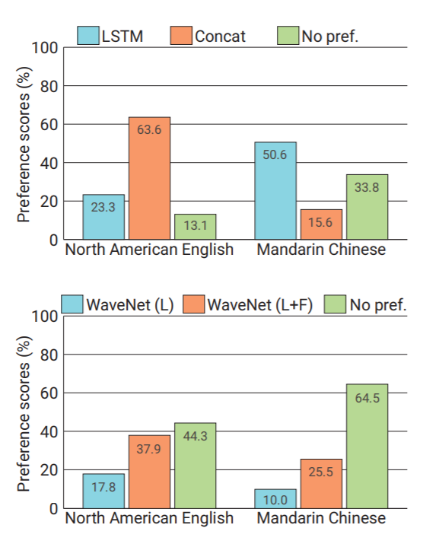
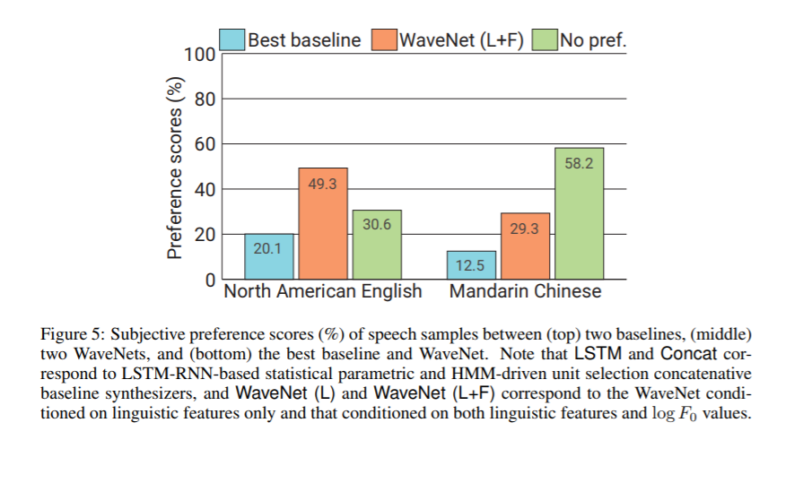
TTS results

Slide 16
Music generation results
YouTube piano dataset
MagnaTagATune dataset
Interesting detail: enlarging the receptive field was crucial to obtain samples that sounded musical. Even with a receptive field of several seconds, the models did not enforce long-range consistency which resulted in second-to-second variations in genre, instrumentation, volume and sound quality

Slide 17


Cons of WaveNet
- Ok,
, I feel so alone that I don’t want to live, what should I do?
WaveNet produces high-quality audio with up to 24,000 samples per second
Hours later…
-
Sounded perfectly natural ;)

Slide 18

Any developments? Parallel WaveNet
Main idea:
Student
Teacher
> 1000 times faster!

Slide 19
References
https://arxiv.org/pdf/1609.03499.pdf;
https://deepmind.com/blog/wavenet-generative-model-raw-audio;
http://www.inference.vc/dilated-convolutions-and-kronecker-factorisation;
http://sergeiturukin.com/2017/03/02/wavenet.html;
https://deepmind.com/blog/high-fidelity-speech-synthesis-wavenet;
https://arxiv.org/pdf/1711.10433.pdf.

